Slide 2
Special Senses
Special sensory receptors
  Distinct, localized receptor cells in head
Vision
Taste
Smell
Hearing
Equilibrium

Slide 3
The Eye and Vision
70% of body's sensory receptors in eye
Visual processing by ~ half cerebral cortex
Most of eye protected by cushion of fat and bony orbit

Slide 4
Accessory Structures of the Eye
Protect the eye and aid eye function
  Eyebrows
  Eyelids (palpebrae)
  Conjunctiva
  Lacrimal apparatus
  Extrinsic eye muscles

Slide 5
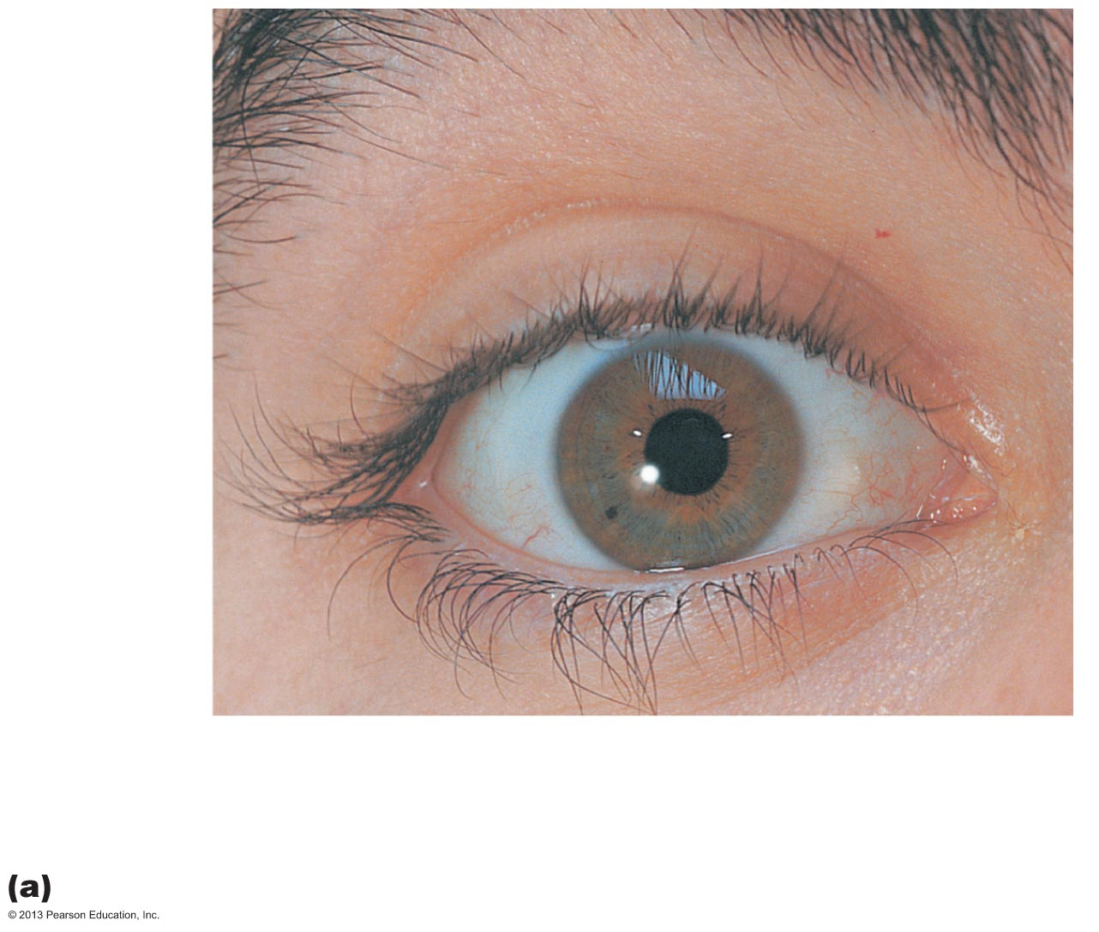
Figure 15.1a The eye and accessory structures.
Eyebrow
Eyelid
Eyelashes
Site where
conjunctiva
merges with
cornea
Palpebral
fissure
Lateral
commissure
Iris
Eyelid
Pupil
Sclera
(covered by
conjunctiva)
Lacrimal
caruncle
Medial
commissure
Surface anatomy of the right eye

Slide 6
Eyebrows
Overlie supraorbital margins
Function
  Shade eye from sunlight
  Prevent perspiration from reaching eye

Slide 7
Eyelids
Protect eye anteriorly
Separated at palpebral fissure
Meet at medial and lateral commissures
Lacrimal caruncle
  At medial commissure
  Contains oil and sweat glands
Tarsal plates—supporting connective tissue

Slide 8
Eyelid Muscles
Levator palpebrae superioris
  Gives upper eyelid mobility
Blink reflexively every 3-7 seconds
  Protection
  Spread secretions to moisten eye

Slide 9
Eyelids
Eyelashes
  Nerve endings of follicles initiate reflex blinking
Lubricating glands associated with eyelids
  Tarsal (Meibomian) glands
    Modified sebaceous glands
    Oily secretion lubricates lid and eye
  Ciliary glands between hair follicles
    Modified sweat glands

Slide 10
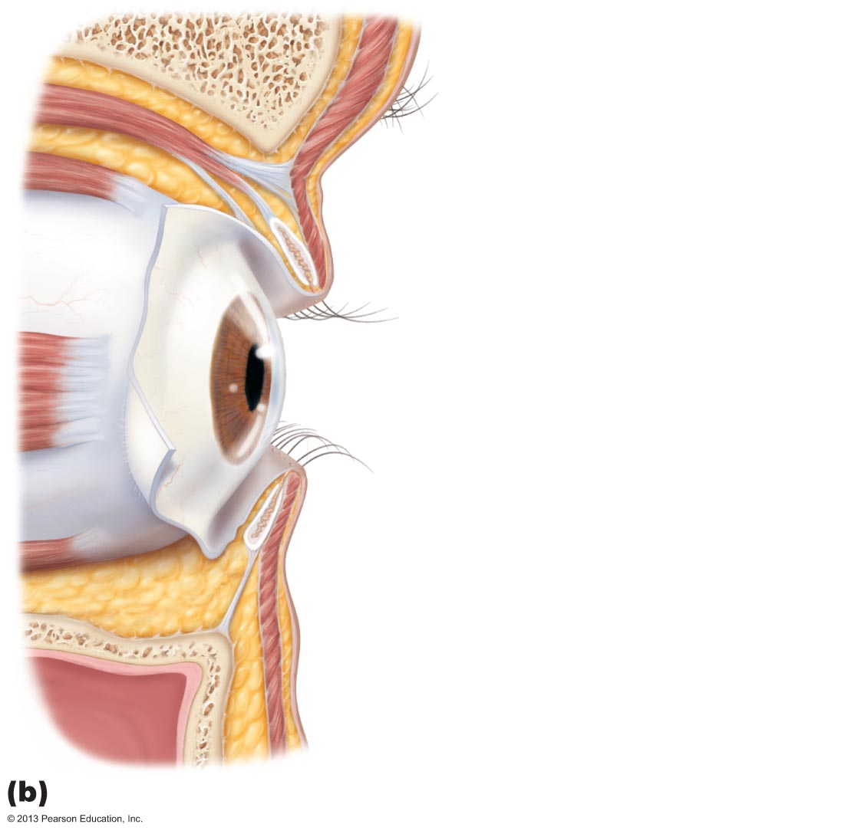
Figure 15.1b The eye and accessory structures.
Levator palpebrae
superioris muscle
Orbicularis
oculi muscle
Eyebrow
Tarsal plate
Palpebral
conjunctiva
Tarsal glands
Cornea
Palpebral
fissure
Eyelashes
Bulbar conjunctiva
Conjunctival sac
Orbicularis
oculi muscle
Lateral view;
some structures shown in sagittal section

Slide 11
Conjunctiva
Transparent mucous membrane
  Produces a lubricating mucous secretion
Palpebral conjunctiva lines eyelids
Bulbar conjunctiva covers white of eyes
Conjunctival sac between palpebral and bulbar conjunctiva
  Where contact lens rests

Slide 12
Lacrimal Apparatus
Lacrimal gland and ducts that drain into nasal cavity
Lacrimal gland in orbit above lateral end of eye
Lacrimal secretion (tears)
  Dilute saline solution containing mucus, antibodies, and lysozyme
  Blinking spreads tears toward medial commissure
  Tears enter paired lacrimal canaliculi via lacrimal puncta
  Then drain into lacrimal sac and nasolacrimal duct

Slide 13
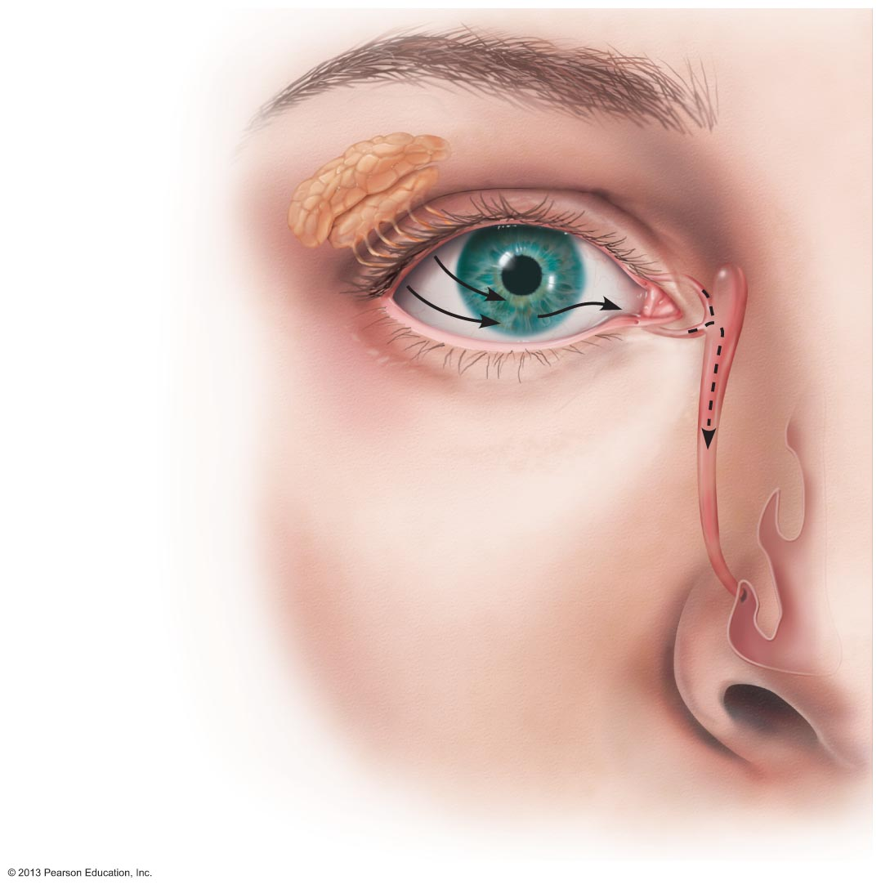
Figure 15.2 The lacrimal apparatus.
Lacrimal sac
Lacrimal gland
Excretory ducts
of lacrimal glands
Lacrimal punctum
Lacrimal canaliculus
Nasolacrimal duct
Inferior meatus
of nasal cavity
Nostril

Slide 14
Extrinsic Eye Muscles
Six straplike extrinsic eye muscles
  Originate from bony orbit; insert on eyeball
  Enable eye to follow moving objects; maintain shape of eyeball; hold in orbit
Four rectus muscles originate from common tendinous ring; names indicate movements
  Superior, inferior, lateral, medial rectus muscles
Two oblique muscles move eye in vertical plane and rotate eyeball
  Superior and inferior oblique muscles

Slide 15
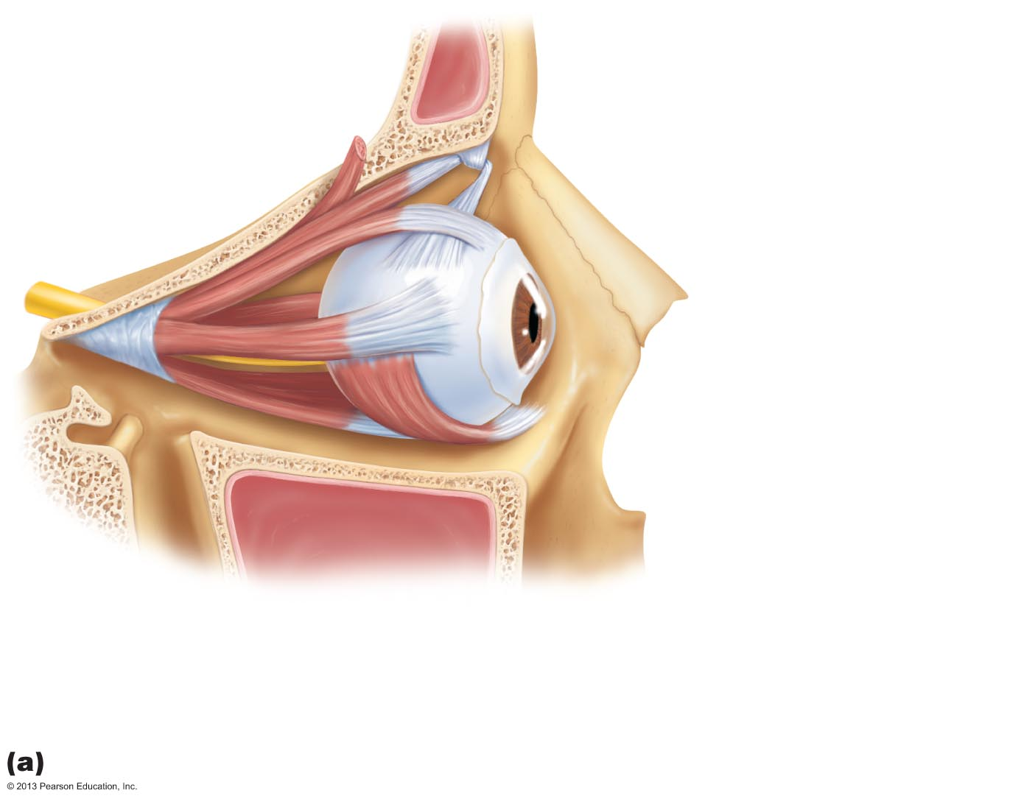
Figure 15.3a Extrinsic eye muscles.
Superior oblique muscle
Superior oblique tendon
Superior rectus muscle
Lateral rectus muscle
Inferior
rectus
muscle
Inferior
oblique
muscle
Lateral view of the right eye

Slide 16
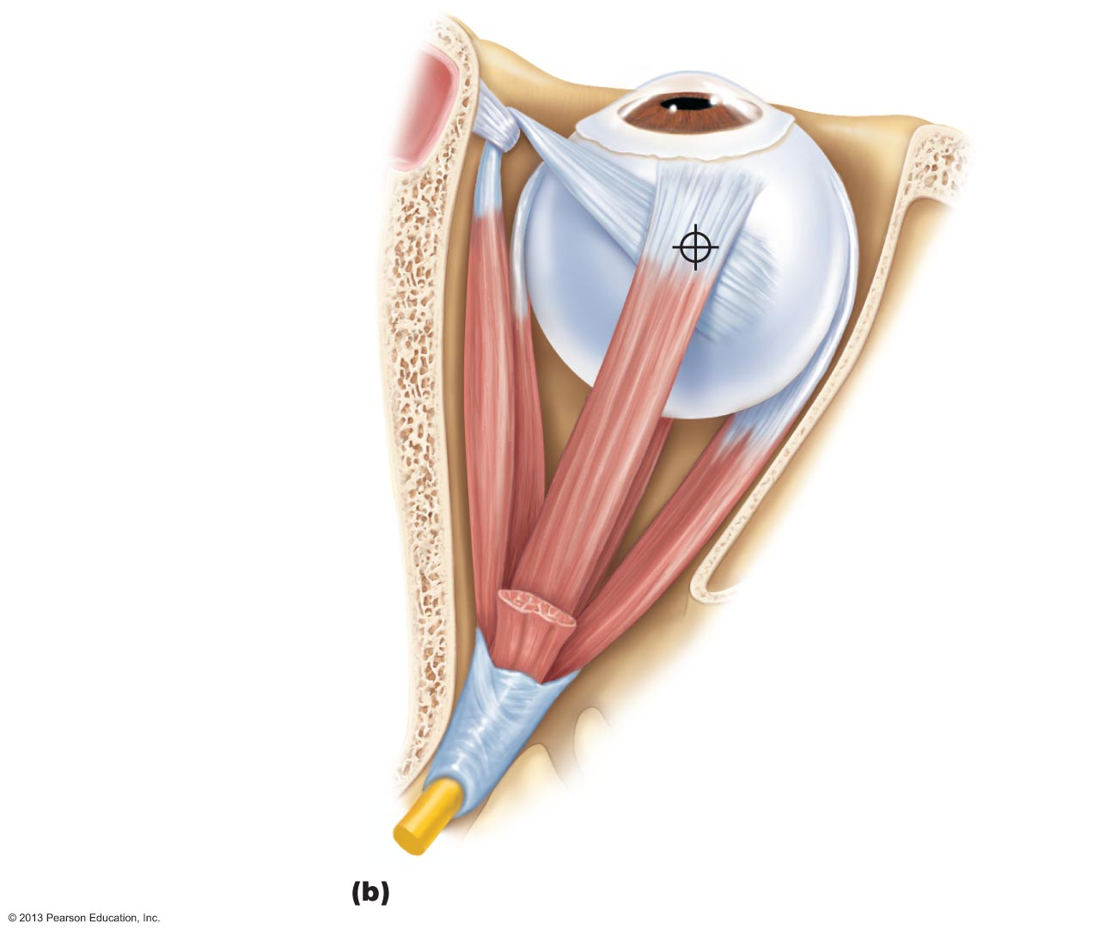
Figure 15.3b Extrinsic eye muscles.
Trochlea
Superior oblique muscle
Superior oblique tendon
Superior rectus muscle
Axis of
rotation
of eye
Inferior
rectus muscle_x0010_
Medial
rectus muscle
Lateral
rectus muscle
Common
tendinous ring
Superior view of the right eye

Slide 17

Figure 15.3c Extrinsic eye muscles.
Muscle
Action
Controlling cranial nerve
Lateral rectus
Moves eye laterally
VI (abducens)
Medial rectus
Moves eye medially
III (oculomotor)
Superior rectus
Elevates eye and turns it medially
III (oculomotor)
Inferior rectus
Depresses eye and turns it medially
III (oculomotor)
Inferior oblique
Elevates eye and turns it laterally
III (oculomotor)
Superior oblique
Depresses eye and turns it laterally
IV (trochlear)
Summary of muscle actions and innervating cranial nerves

Slide 18
Structure of the Eyeball
Wall of eyeball contains three layers
  Fibrous
  Vascular
  Inner
Internal cavity filled with fluids called humors
Lens separates internal cavity into anterior and posterior segments (cavities)

Slide 19
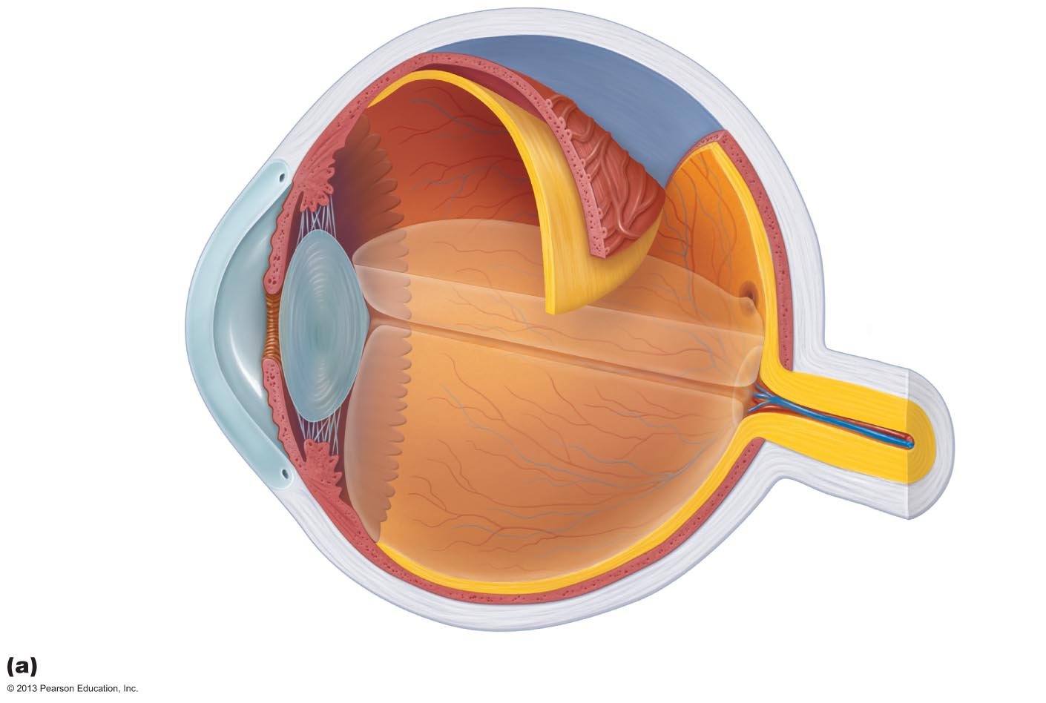
Figure 15.4a Internal structure of the eye (sagittal section).
Ora serrata
Ciliary body
Sclera
Ciliary zonule
(suspensory
ligament)
Choroid
Retina
Macula lutea
Cornea
Iris
Fovea centralis
Pupil
Posterior pole
Anterior
pole
Optic nerve
Anterior
segment
(contains
aqueous humor)
Lens
Central artery and
vein of the retina
Scleral venous sinus
Posterior segment
(contains vitreous humor)
Optic disc
(blind spot)
Diagrammatic view. The vitreous humor is illustrated only in the bottom part of the eyeball.

Slide 20
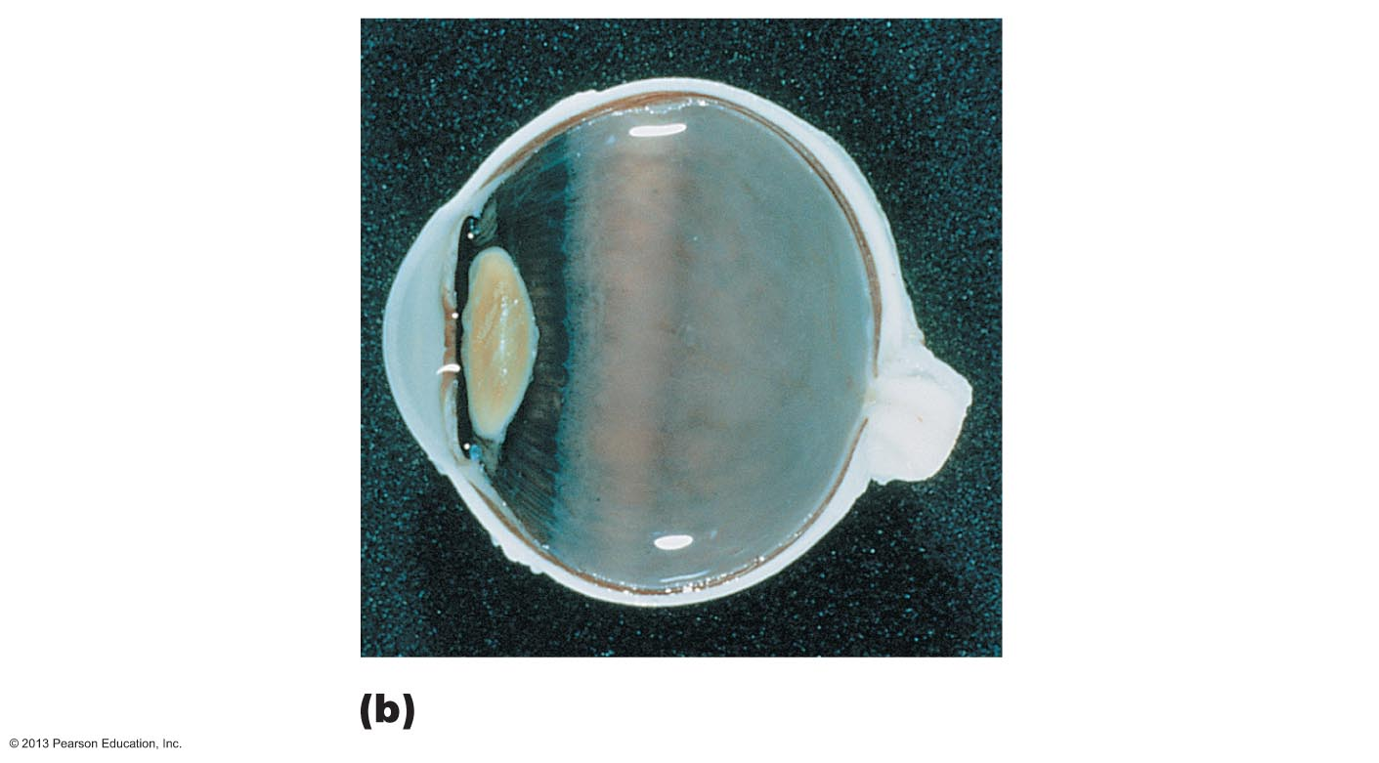
Figure 15.4b Internal structure of the eye (sagittal section).
Ciliary body
Vitreous humor
in posterior
segment
Ciliary
processes
Iris
Retina
Margin
of pupil
Choroid
Sclera
Anterior
segment
Fovea centralis
Optic disc
Lens
Optic nerve
Cornea
Ciliary zonule
(suspensory
ligament)
Photograph of the human eye.

Slide 21
Fibrous Layer
Outermost layer; dense avascular connective tissue
Two regions: sclera and cornea
  1. Sclera
    Opaque posterior region
    Protects, shapes eyeball; anchors extrinsic eye muscles
    Continuous with dura mater of brain posteriorly

Slide 22
Fibrous Layer
  2. Cornea
    Transparent anterior 1/6 of fibrous layer
    Bends light as it enters eye
    Sodium pumps of corneal endothelium on inner face help maintain clarity of cornea
    Numerous pain receptors contribute to blinking and tearing reflexes

Slide 23
Vascular Layer (Uvea)
Middle pigmented layer
Three regions: choroid, ciliary body, and iris
  1. Choroid region
    Posterior portion of uvea
    Supplies blood to all layers of eyeball
    Brown pigment absorbs light to prevent light scattering and visual confusion

Slide 24
Vascular Layer
  2. Ciliary body
    Ring of tissue surrounding lens
    Smooth muscle bundles (ciliary muscles) control lens shape
    Capillaries of ciliary processes secrete fluid
    Ciliary zonule (suspensory ligament) holds lens in position

Slide 25
Vascular Layer
  3. Iris
    Colored part of eye
    Pupil—central opening that regulates amount of light entering eye
      Close vision and bright light—sphincter pupillae (circular muscles) contract; pupils constrict
      Distant vision and dim light—dilator pupillae (radial muscles) contract; pupils dilate – sympathetic fibers
      Changes in emotional state—pupils dilate when subject matter is appealing or requires problem-solving skills

Slide 26
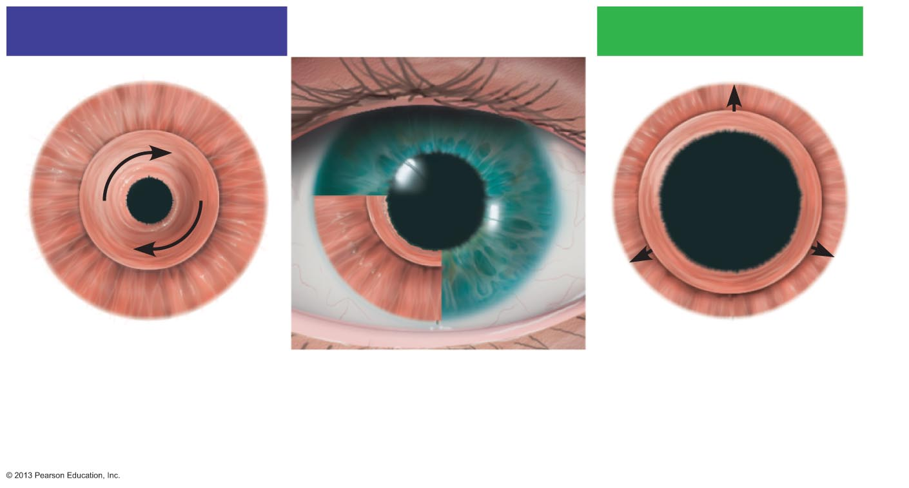
Figure 15.5 Pupil constriction and dilation, anterior view.
Parasympathetic +
Sympathetic +
Sphincter pupillae
muscle contracts:
Pupil size decreases.
Iris (two muscles)
• Sphincter pupillae
• Dilator pupillae
Dilator pupillae
muscle contracts:
Pupil size increases.

Slide 27
Inner Layer: Retina
Originates as outpocketing of brain
Delicate two-layered membrane
  Outer Pigmented layer
    Single-cell-thick lining
    Absorbs light and prevents its scattering
    Phagocytize photoreceptor cell fragments
    Stores vitamin A

Slide 28
Inner Layer: Retina
  Inner Neural layer
    Transparent
    Composed of three main types of neurons
      Photoreceptors, bipolar cells, ganglion cells
    Signals spread from photoreceptors to bipolar cells to ganglion cells
    Ganglion cell axons exit eye as optic nerve

Slide 29
The Retina
Optic disc (blind spot)
  Site where optic nerve leaves eye
  Lacks photoreceptors
Quarter-billion photoreceptors of two types
  Rods
  Cones

Slide 30
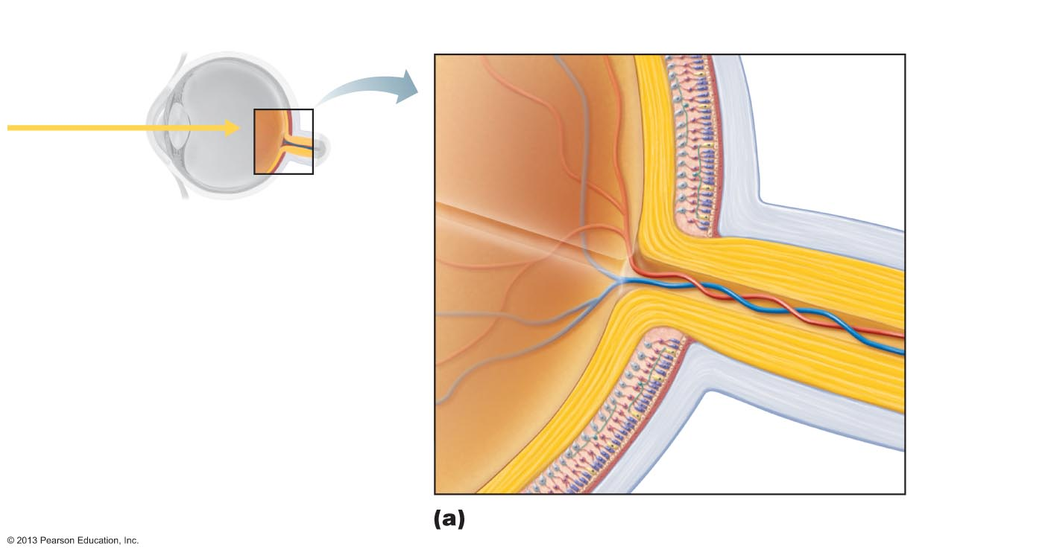
Figure 15.6a Microscopic anatomy of the retina.
Neural layer of retina
Pigmented
layer of
retina
Pathway of
light
Choroid
Sclera
Optic disc
Central artery
and vein of retina
Optic
nerve
Posterior aspect of the eyeball

Slide 31
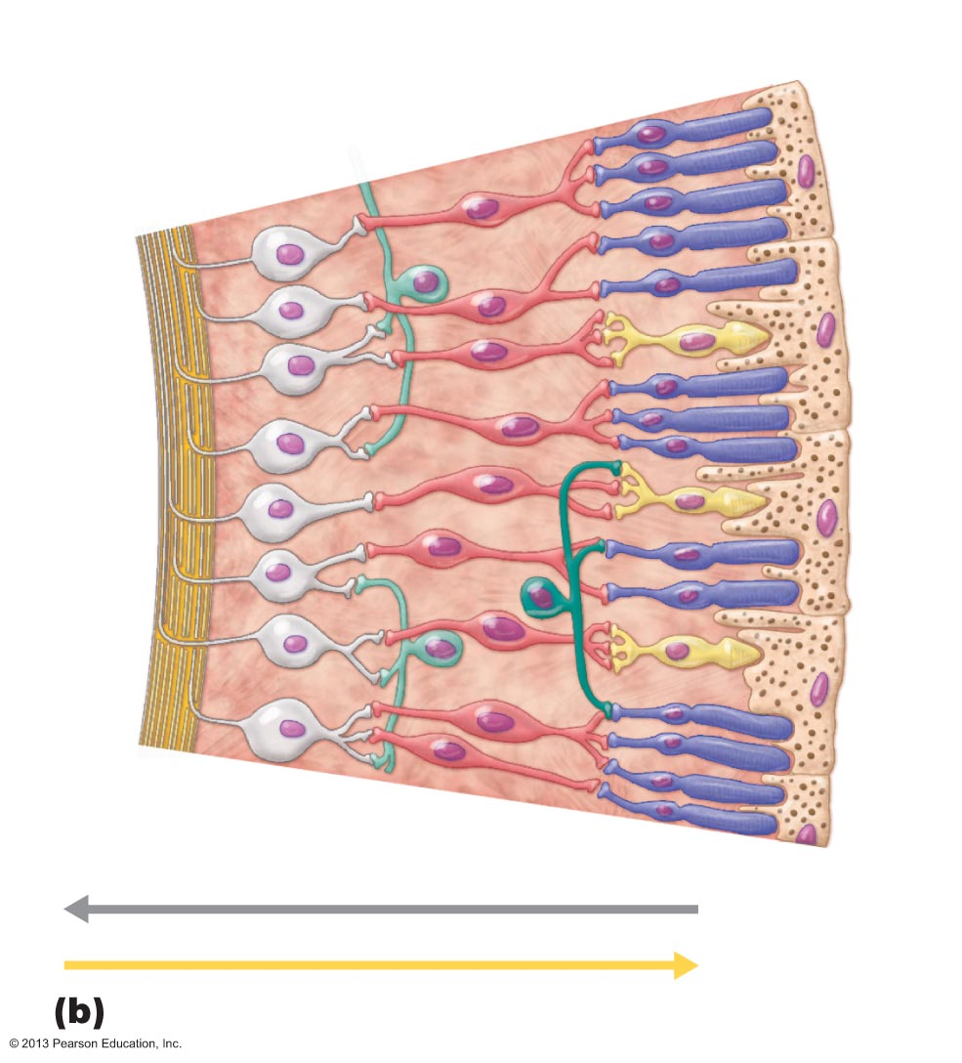
Figure 15.6b Microscopic anatomy of the retina.
Ganglion
cells
Bipolar
cells
Photoreceptors
• Rod
Axons
of
ganglion
cells
• Cone
Amacrine cell
Horizontal cell
Pathway of signal output
Pathway of light
Pigmented
layer of retina
Cells of the neural layer of the retina

Slide 32
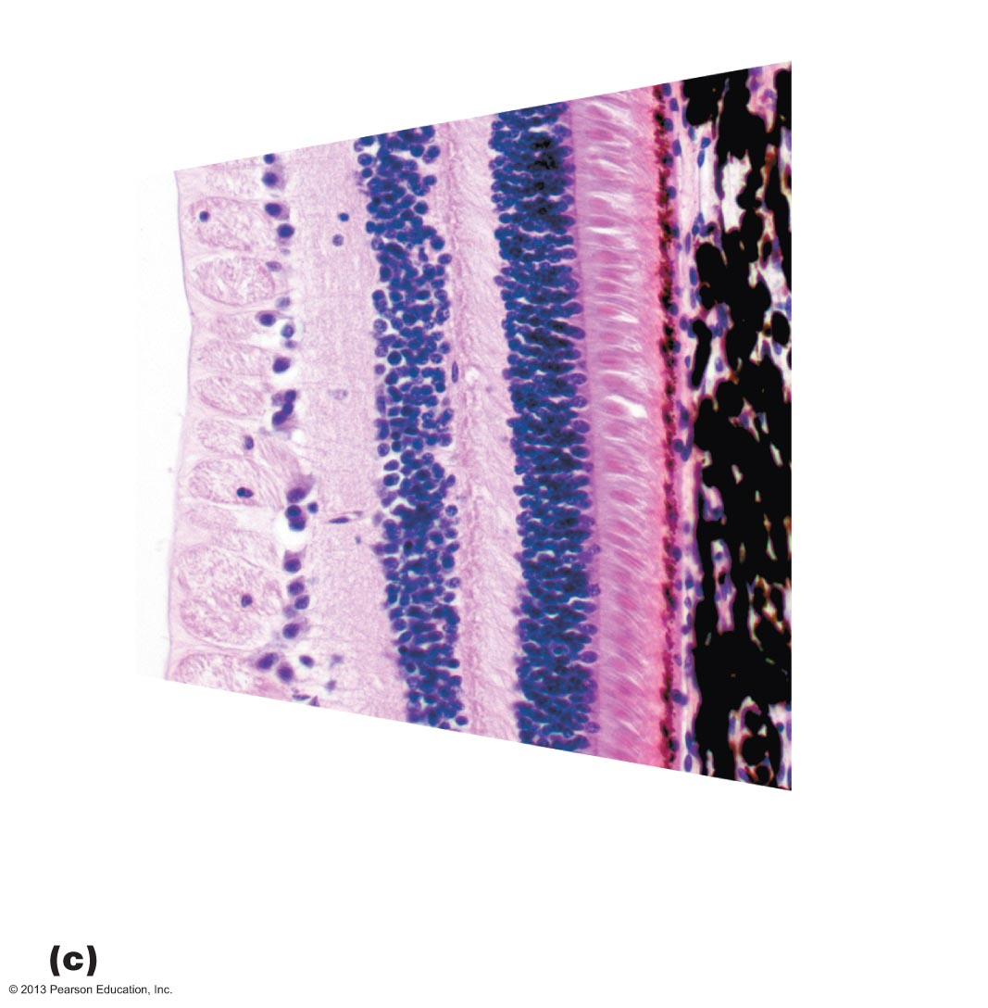
Figure 15.6c Microscopic anatomy of the retina.
Choroid
Outer segments
of rods and cones
Nuclei of
ganglion
cells
Nuclei of
bipolar
cells
Nuclei of
rods and
cones
Axons of
ganglion cells
Pigmented
layer of retina
Photomicrograph of retina

Slide 33
Photoreceptors
Rods
  Dim light, peripheral vision receptors
  More numerous, more sensitive to light than cones
  No color vision or sharp images
  Numbers greatest at periphery

Slide 34
Photoreceptors
Cones
  Vision receptors for bright light
  High-resolution color vision
  Macula lutea exactly at posterior pole
    Mostly cones
    Fovea centralis
      Tiny pit in center of macula with all cones; best vision

Slide 35
Blood Supply to the Retina
Two sources of blood supply
  Choroid supplies outer third (photoreceptors)
  Central artery and vein of retina supply inner two-thirds
    Enter/exit eye in center of optic nerve
    Vessels visible in living person

Slide 36
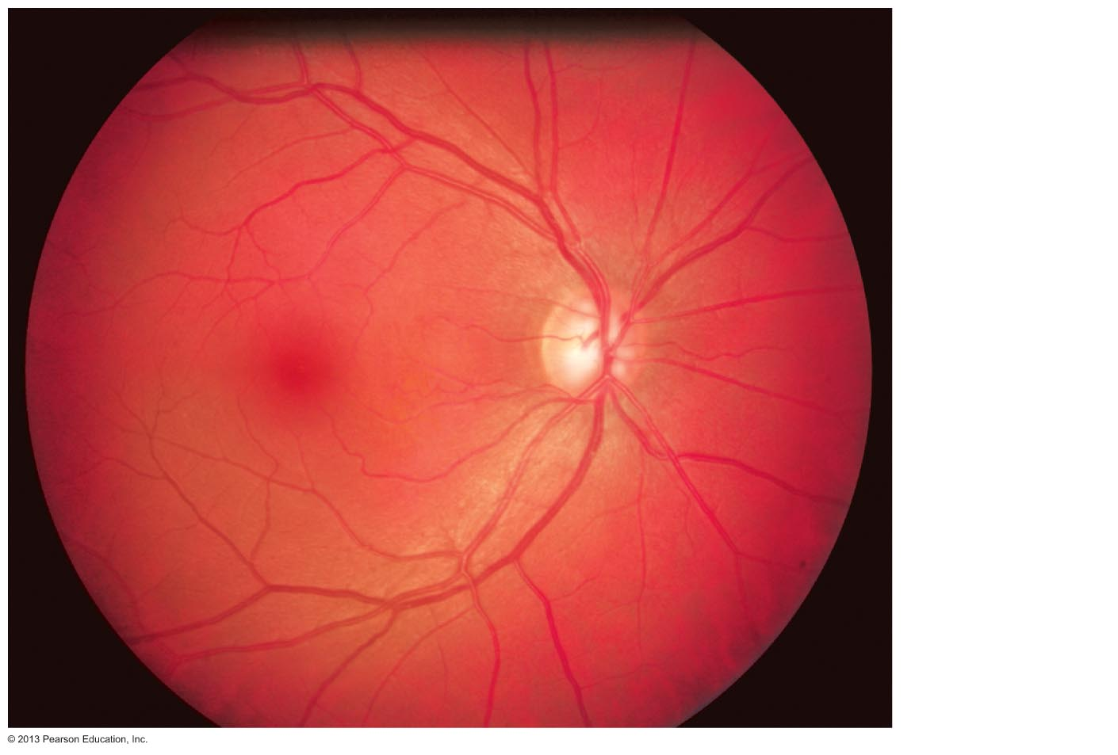
Figure 15.7 Part of the posterior wall (fundus) of the right eye as seen with an ophthalmoscope.
Central
artery
and vein
emerging
from the
optic disc
Optic disc
Macula
lutea
Retina

Slide 37
Internal Chambers and Fluids
The lens and ciliary zonule separate eye into two segments
  Anterior and posterior segments

Slide 38
Internal Chambers and Fluids
Posterior segment contains vitreous humor that
  Transmits light
  Supports posterior surface of lens
  Holds neural layer of retina firmly against pigmented layer
  Contributes to intraocular pressure
  Forms in embryo; lasts lifetime
Anterior segment composed of two chambers
  Anterior chamber—between cornea and iris
  Posterior chamber—between iris and lens

Slide 39
Internal Chambers and Fluids
Anterior segment contains aqueous humor
  Plasma like fluid continuously formed by capillaries of ciliary processes
  Drains via scleral venous sinus (canal of Schlemm) at sclera-cornea junction
  Supplies nutrients and oxygen mainly to lens and cornea but also to retina, and removes wastes
Glaucoma: blocked drainage of aqueous humor increases pressure and causes compression of retina and optic nerve → blindness

Slide 40
Figure 15.4a Internal structure of the eye (sagittal section).
Ora serrata
Ciliary body
Sclera
Ciliary zonule
(suspensory
ligament)
Choroid
Retina
Macula lutea
Cornea
Iris
Fovea centralis
Pupil
Posterior pole
Anterior
pole
Optic nerve
Anterior
segment
(contains
aqueous humor)
Lens
Central artery and
vein of the retina
Scleral venous sinus
Posterior segment
(contains vitreous humor)
Optic disc
(blind spot)
Diagrammatic view. The vitreous humor is illustrated only in the bottom part of the eyeball.

Slide 41
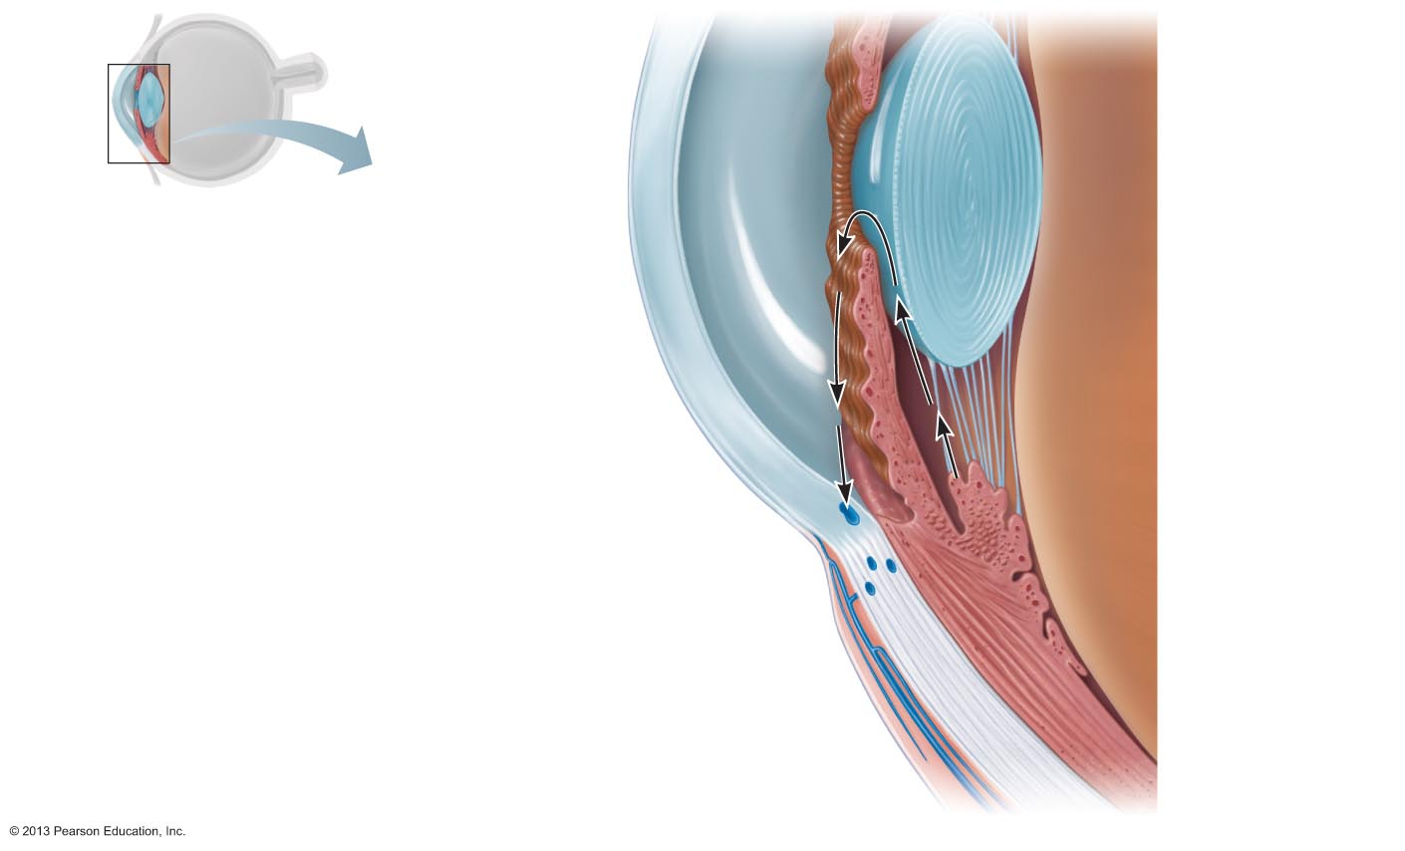
Figure 15.8 Circulation of aqueous humor.
Posterior
segment
(contains
vitreous
humor)
Cornea
Lens
Iris
Lens epithelium
Lens
Cornea
2
Corneal epithelium
Corneal endothelium
Aqueous humor
Aqueous humor
forms by filtration
from the capillaries
in the ciliary
processes.
1
Anterior chamber
Anterior
segment
(contains
aqueous
humor)
Ciliary zonule
(suspensory
ligament)
Posterior chamber
Aqueous humor
flows from the
posterior chamber
through the pupil into
the anterior chamber.
Some also flows
through the vitreous
humor (not shown).
2
Scleral venous
sinus
3
1
Ciliary
processes
Corneoscleral
junction
Ciliary
body
Ciliary
muscle
Bulbar
conjunctiva
Aqueous humor is
reabsorbed into the
venous blood by the
scleral venous sinus.
3
Sclera

Slide 42
Lens
Biconvex, transparent, flexible, and avascular
Changes shape to precisely focus light on retina
Two regions
  Lens epithelium anteriorly; Lens fibers form bulk of lens
  Lens fibers filled with transparent protein crystallin
  Lens becomes more dense, convex, less elastic with age
    cataracts (clouding of lens) consequence of aging, diabetes mellitus, heavy smoking, frequent exposure to intense sunlight

Slide 43
Cataracts
Clouding of lens
  Consequence of aging, diabetes mellitus, heavy smoking, frequent exposure to intense sunlight
  Some congenital
  Crystallin proteins clump
  Vitamin C increases cataract formation
  Lens can be replaced surgically with artificial lens

Slide 44
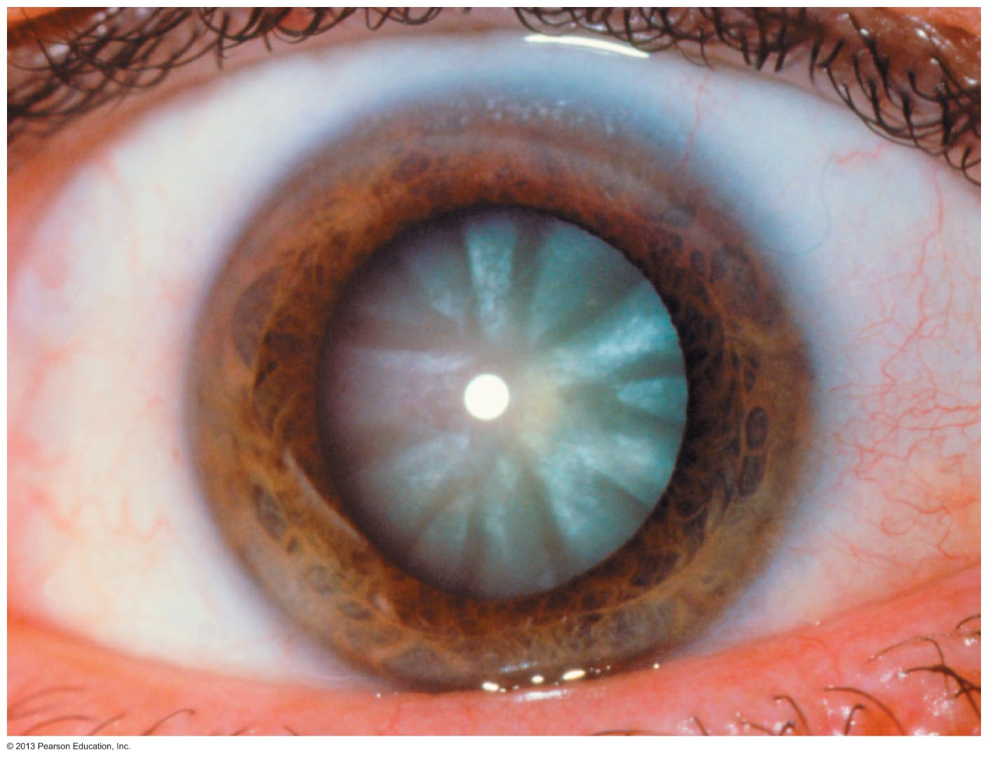
Figure 15.9 Photograph of a cataract.

